Slide 1
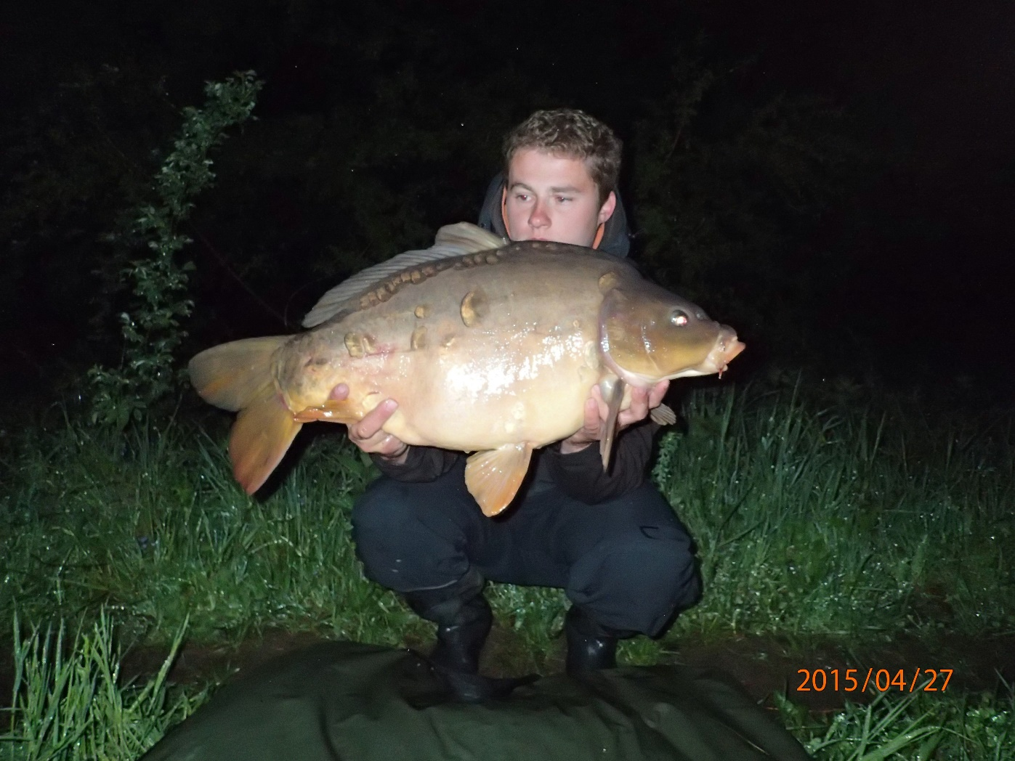
Carp farming

Slide 2
Carp biology
• Origins: the original homeland of the carp are the basins of the Black Sea, the Caspian Sea and the Aral Sea. In the Tertiary period, it reached the Danube basin. In this way, it managed to get to our territory via the Morava and Dyje rivers.
• Food: Carp is exclusively omnivorous, eating zooplankton and zoobenthos (insect larvae, small aquatic crustaceans). It also accepts cereals, which are digested very well and also serve as a source of energy.
• Oxygen demand: the optimum is 5 – 7 mg. l-1 O2. But it safely tolerates a concentration of 3-4 mg. l-1.

Slide 3
Carp biology
• Growth – Depending on the environmental conditions, it can grow relatively fast in our country.
Indicative values
• K1: Yearling carp 25 – 100 g (50 – 120 mm)
• K2: Two year old carp 250 – 700 g (200 – 350 mm)
• K3: Three year old carp 1000 – 1800 g (400 – 500 mm)
• K4: Four year old carp over 2500 g
• Record catches are over 20 kg.
• Sexual maturity – in the 3rd year milkfish and in the 4th year spawners

Slide 4
Carp biology
• Fertility: 150 – 250,000 eggs per 1 kg of live weight. Roe size: 1.3 – 1.8 mm.
• Spawning – in the spring months (April, May) at a water temperature above 18 degrees C. Spawning is phytophilic: on submerged plants

Slide 5
Carp scales
In breeding, there are four morphological groups of phenotypes according to the scaly cover:
• Scaly carp – the whole body is covered with scales
• Row carp – the scales are at the base of the fins, a single or double row on the lateral line.
• Coot carp – scales scattered across the back and belly like islands
• Smooth carp - strong reduction of scales, only supporting scales at the base of the fins, which may be missing.
• Carp breeding work : it is provided by VÚRH Vodňany, SRTábor
• (Milevsko centre). The testing stations are here.
• Breeding farms – Blatná, Třeboň, Hodonín.

Slide 6
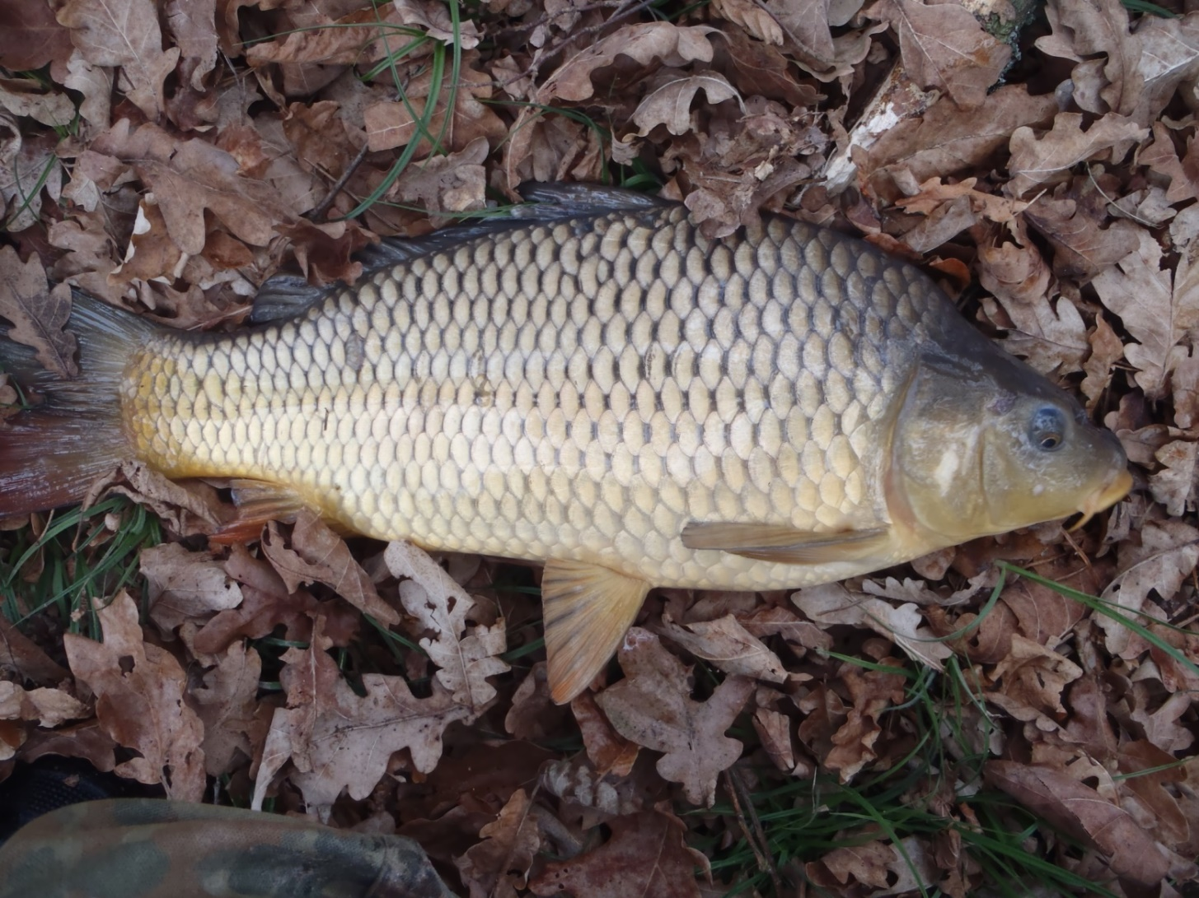

Slide 7
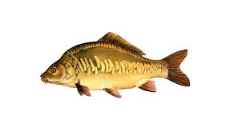
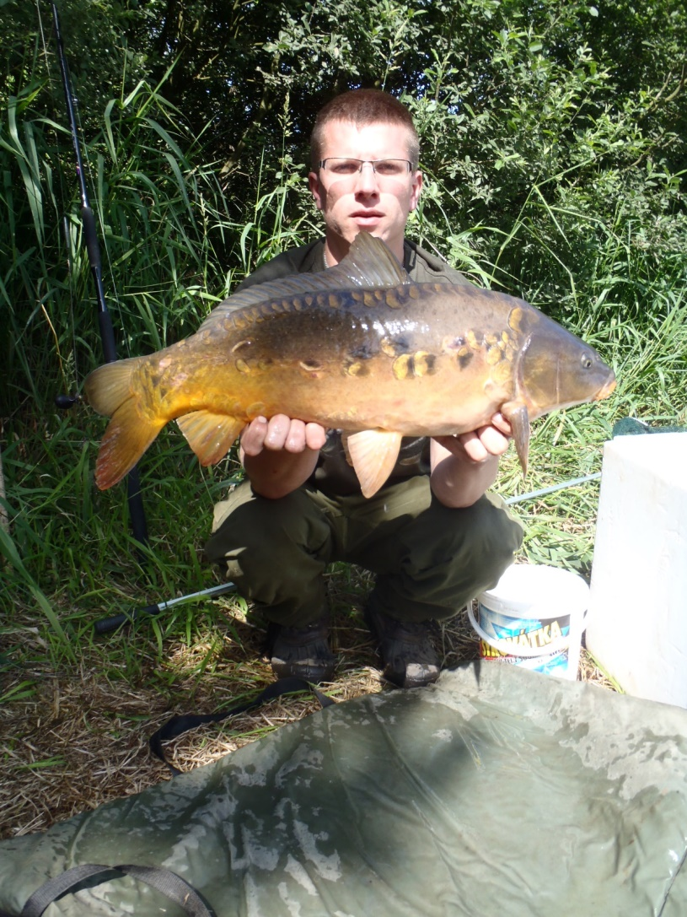
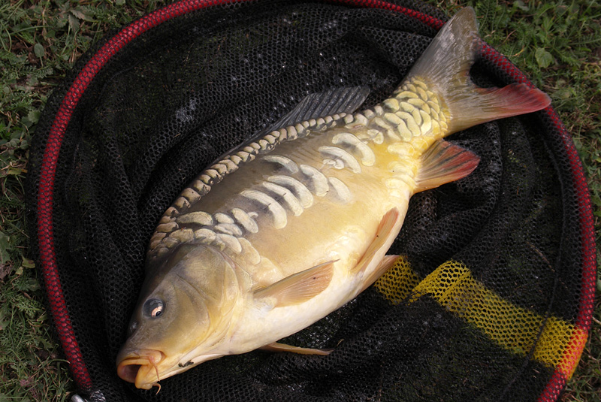

Slide 8
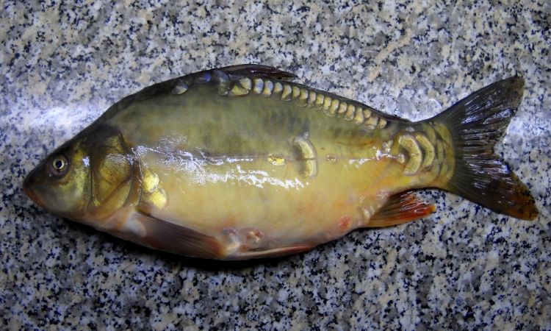

Slide 9
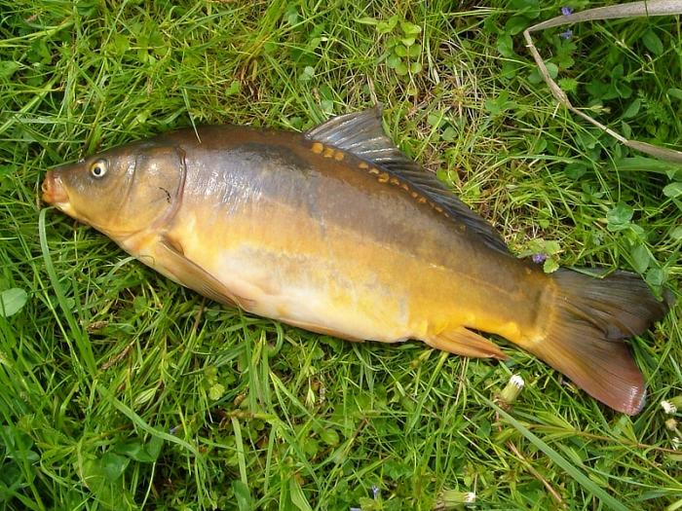

Slide 10
Carp breeding
Full or partial breeding of carp
• Complete –from roe to market fish (complete farming)
• Partial – From roe to fry or stock or from fry or stock to market fish.
• Our fish farm operates according to a 3 to 4 year economic cycle.
• The economic cycle is the period from roe to marketable fish.

Slide 11
Economic cycles of carp
Ko – carp embryo just after hatching up to the age of 4-6 weeks placed in the first stage ponds or fry ponds
Kr – carp from 4.5 cm in size and 5-10 g placed in the second stage ponds
and caught in autumn as K1
K1 – carp fry between a half to one year old caught in autumn or spring,
(25-100g, 50-100mm)
K2 – stock (age one and a half to two years) reared in hatchery ponds, (250-700 g, 200-350 mm)

Slide 12
Economic cycles of carp
• K3 – three year old (so called market) carp intended for delivery to the market with a total weight of about 1,200-1,800 g and a size of between 400-500 mm reared in the so called main pond
• K4 – four year old, market carp reared in the main "two year" pond, usually weighing more than 2,500 g (selection)
• Krem – future generation carp (we still select the best pieces suitable for spawning)
• Kg – generation intended for reproduction. The highest breeding values ​​reach Kg at the age of 7-8 years.

Slide 13
Types of ponds
1st and 2nd stage fry ponds : they are a bit muddy with high fertility and only up to a few ha. THey must have good technical conditions, reliable inflow and a bypass drain. Optimum average depth of 80 cm, in the fishing ground 150-200 cm.
Breeding ponds : K2 (breeding carp) is reared here.
The quality of the ponds is different (fertile, average and worse).
They are mostly ponds left over after separation from fry fishponds.
Sizes from 1 ha to several 10 ha

Slide 14
Types of ponds
Main ponds - one or two years
They are used to breed market fish
Fertility - good and high (ponds often flowing and muddy).
period of use is 1 to 2 years.
The depth requirements are: diameter 100 cm,
in the fishing ground 200 cm.

Slide 15
Other types of ponds and reservoirs
Chamber ponds – for overwintering fish,
depth 2.5m
Maternal ponds – used for spawning
Handling ponds – for short-term storage
Dubravio's ponds - used for spawning
Quarantine ponds or tanks – for sick or newly imported fish
Fish pens- used for keeping or storing fish, etc

Slide 16
Pond species
single-species (monocultural): Only carp, zander or pike. Most species are reared within one year of life in monoculture.
multi-species (polycultural): Carp and other types of fish.
normal stocks : The pond is not restocked , the stock grows normally.
thickened (increased) stocks: The stock is increased twice of more times, the amount of extra stock depending on the additional feeding of the fish.

Slide 17
Polycultural stock
• Offers the best use of natural food in the pond.
• This is the most widespread type of stock.
• It is important to choose the right composition of the pond so that there is no competition for food and there is no suspension of the growth from any of the fish.
That is why it is important to know the biology of individual species and their food claims.

Slide 18
Examples: carp - tench
L2 together with the carp stock(K2) in the range of 5-30% of the weight of the planned increase in K.
The ratio can be up to 1:1.

Slide 19
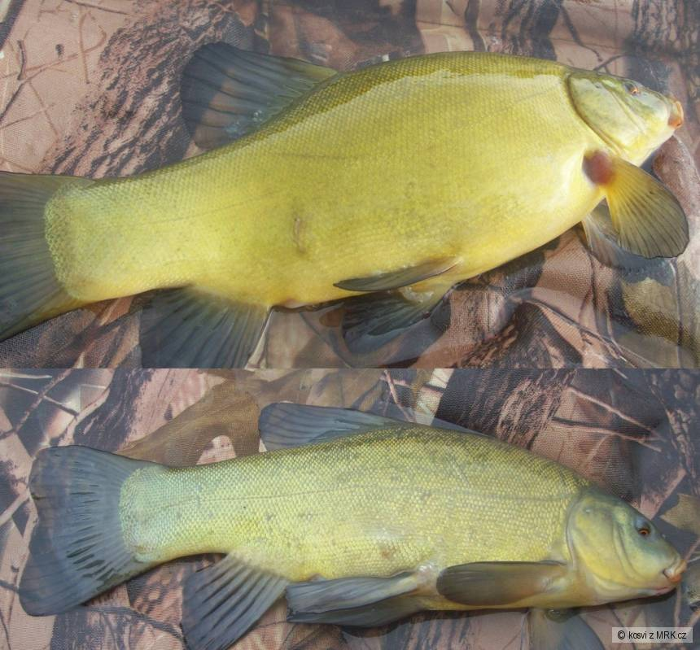
Tench

Slide 20
Polycultural stock
Carp – herbivorous fish (Silver carp, Grass carp)
and Bighead carp
Ponds in warmer areas are suitable
Herbivorous fish use phytoplankton, detritus and soft higher water flora.
Supplementation with green fodder, e.g. alfalfa, can also be used
Recommended polyculture:
50% Carp, 20-25% Silver carp, 10-15% Bighead carp, 5-15% Grass carp
Result: increased overall production

Slide 21
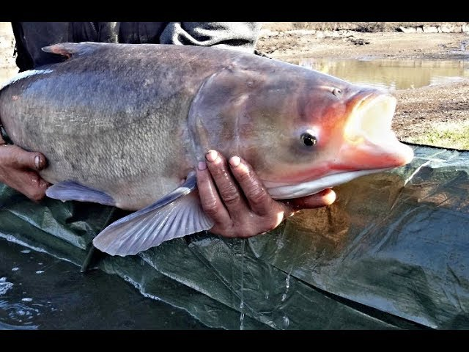
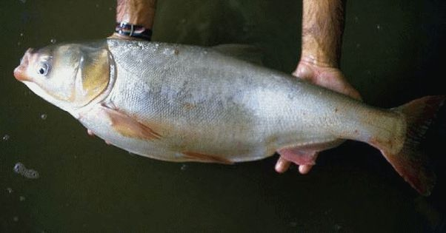
Bighead carp
Silver carp

Slide 22
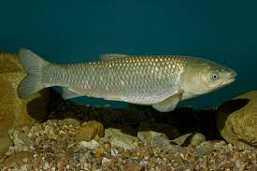
Grass carp

Slide 23
Polycultural stock
Carp - predatory fish
• Suitable for ponds with weed fish.
• Carp + Pike:
• Main ponds: C2-3 + approx. 6 pieces of P2/ha,
Breeding ponds: C1 + 10-50 pcs P1/ha,
Carp + Zander:
Main ponds: C2-3 + up to 15 pcs of Z2/ha,
Breeding ponds: C1 + 50-150 Z1/ha
Carp + Catfish:
Main ponds: C2-3 + up to 50 pcs Cat2/ha
Breeding ponds: C1 + 50-150 pcs Cat1/ha

Slide 24
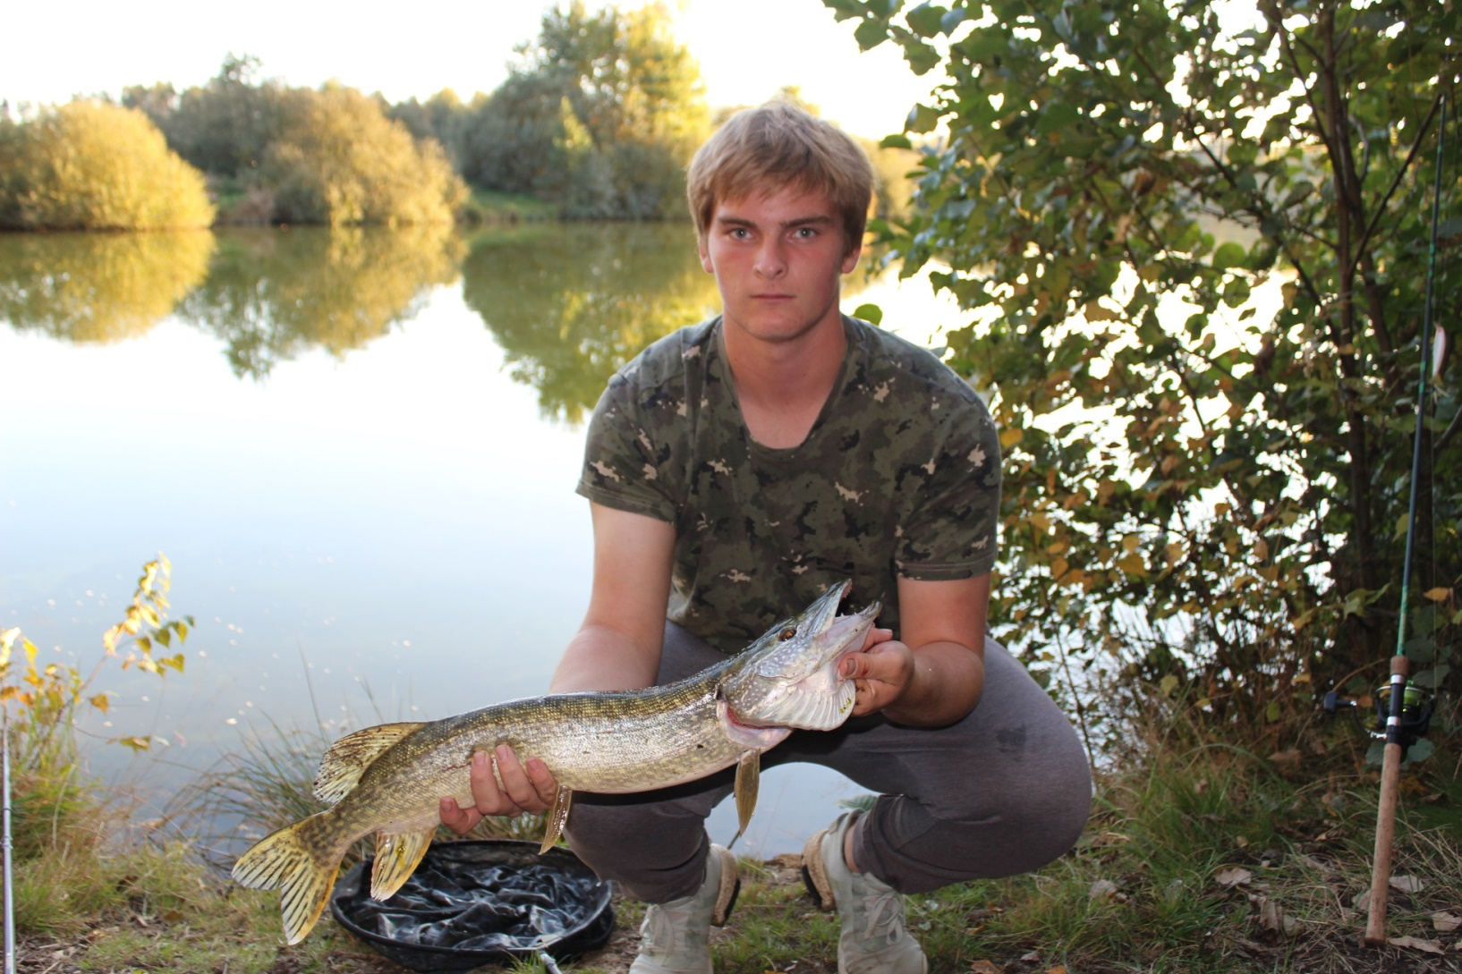
Northern pike

Slide 25
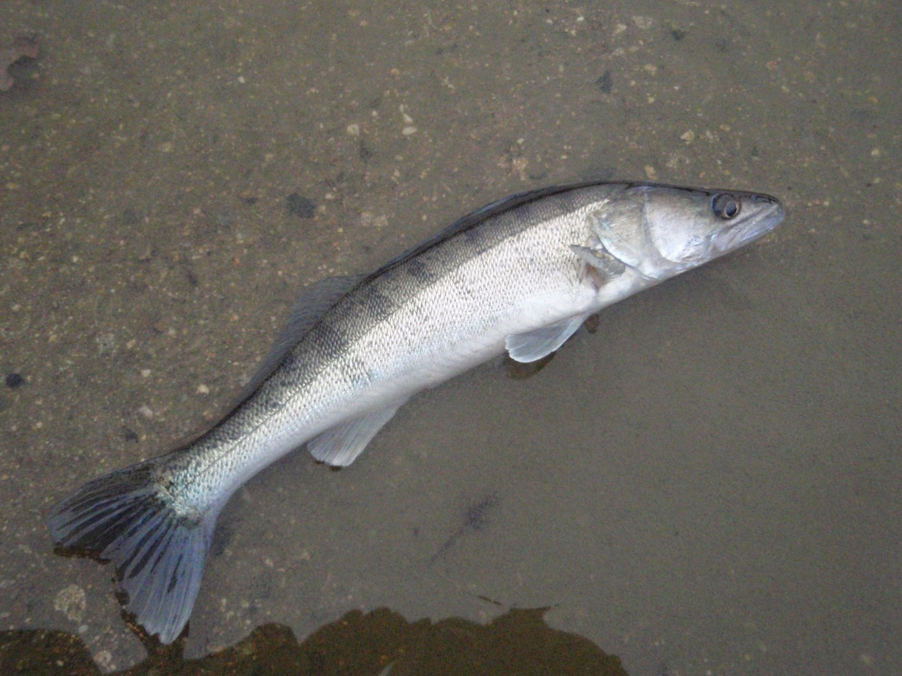
Zander

Slide 26
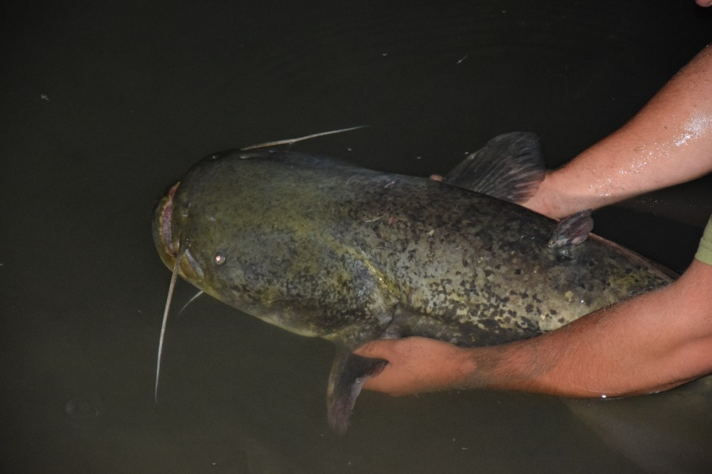
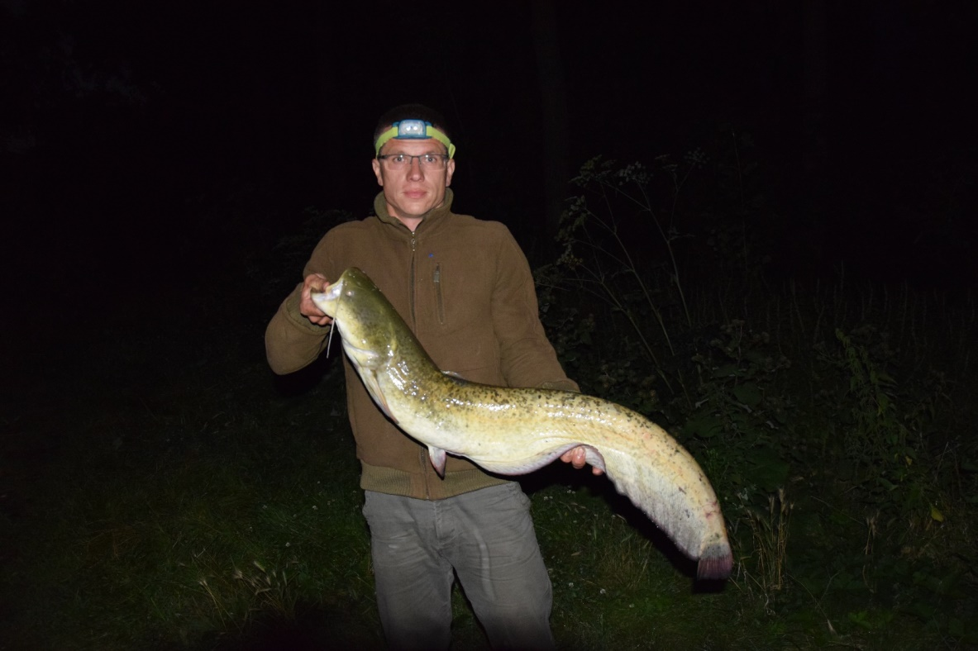
Catfish

Slide 27
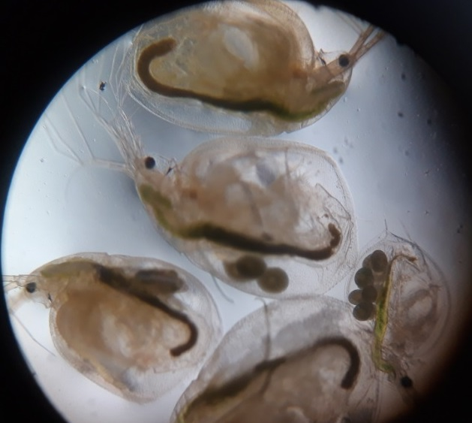
Zooplankton- fish food

Slide 28
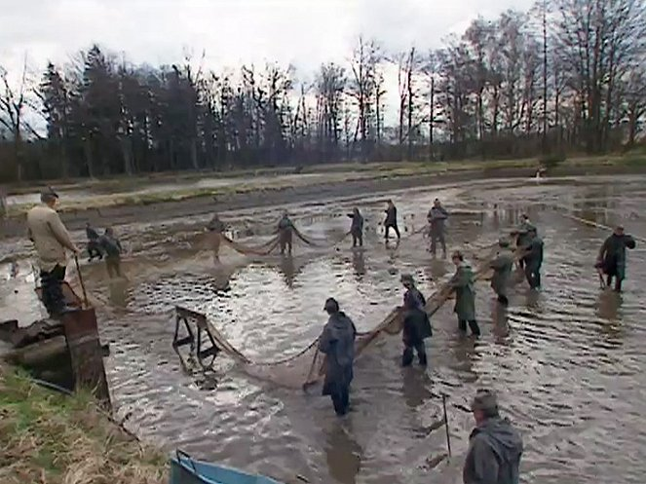
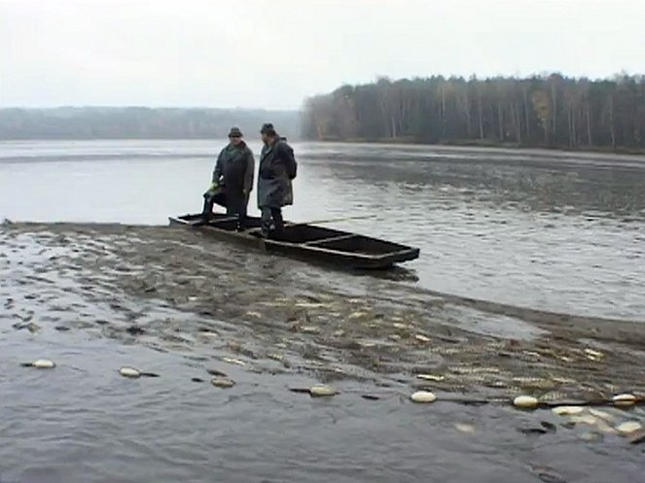
Fish harvest

Slide 29
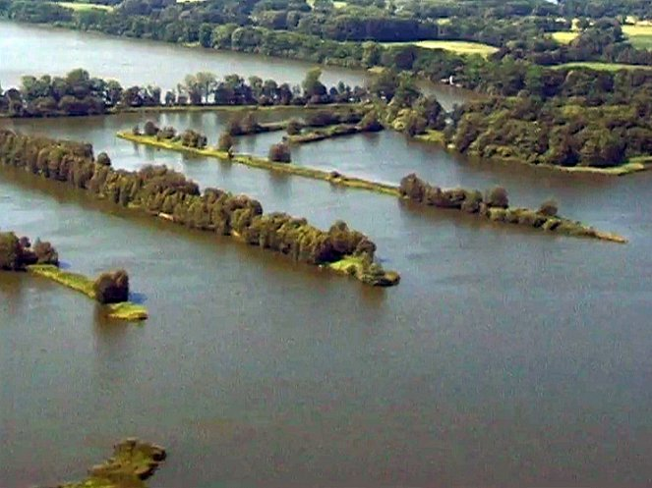
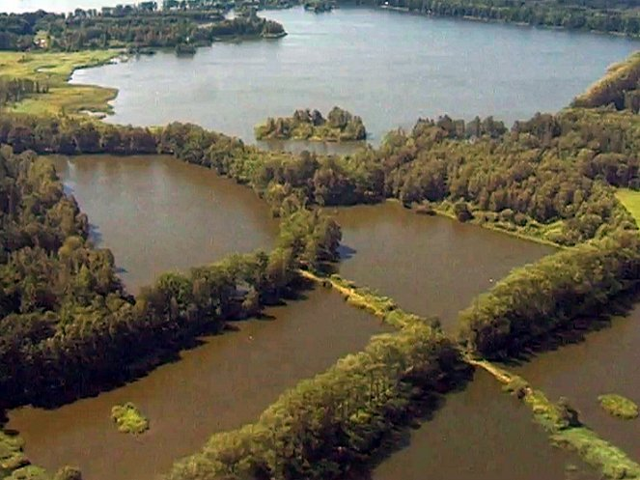
Třeboň region

Slide 30
Resources
https://www.google.com/search?q=amur+bílý&client=opera&hs=ne3&source=lnms&tbm=isch&sa=X&ved=2ahUKEwjthKPWrrb3AhUMyKQKHUCOBUAQ_AUoAXoECAIQAw&biw=758&bih=358&dpr=1.75#imgrc=NxnWysQrvJaYbM
Mrk.cz
https://www.google.com/search?q=tolstolobik+bílý&tbm=isch&ved=2ahUKEwiznov_rrb3AhUkuqQKHfGSC_QQ2-cCegQIABAA&oq=tolstolobik+bílý&gs_lcp=CgNpbWcQAzIFCAAQgAQyBAgAEBg6BAgAEEM6CAgAELEDEIMBOggIABCABBCxAzoLCAAQgAQQsQMQgwE6BwgAELEDEEM6BAgAEB46BggAEAgQHlDtBFimNGCwOWgAcAB4AYABWogB7wqSAQIyNZgBAKABAaoBC2d3cy13aXotaW1nsAEAwAEB&sclient=img&ei=-lNqYrO5BaT0kgXxpa6gDw&bih=358&biw=758&client=opera&hs=ne3#imgrc=Y9Mil_tJhR8-EM
https://www.google.com/search?q=tolstolobik+bílý&tbm=isch&ved=2ahUKEwiznov_rrb3AhUkuqQKHfGSC_QQ2-cCegQIABAA&oq=tolstolobik+bílý&gs_lcp=CgNpbWcQAzIFCAAQgAQyBAgAEBg6BAgAEEM6CAgAELEDEIMBOggIABCABBCxAzoLCAAQgAQQsQMQgwE6BwgAELEDEEM6BAgAEB46BggAEAgQHlDtBFimNGCwOWgAcAB4AYABWogB7wqSAQIyNZgBAKABAaoBC2d3cy13aXotaW1nsAEAwAEB&sclient=img&ei=-lNqYrO5BaT0kgXxpa6gDw&bih=358&biw=758&client=opera&hs=ne3#imgrc=vH4hwOGy3W2gYM

