Slide 1
First mentions of the ponds
• From 993, there is the first indirect record of the settlement of "Rybníček„ near Prague, today's Prague street "Na rybníčku„ near Karlovo náměstí
• The chronicle of the Czechs in 1034, handover of the pond to the Sázava Monastery
• Founding document of the Kladruby Monastery in 1115
• Foundation charter of Přemysl Otakar II. In 1227, permits the construction of ponds
• At the end of the 13th century there are about 10,000 ha of pond area with an average annual production of 20-30 kg/ha. The fish are bred using the cumulative method, i.e. all categories together, they are caught once every 5-6 years. Fish production is consumed around the ponds and monasteries, with limited sales to the cities.

Slide 2
. The flourishing of pond farming in Bohemia and Moravia
Charles IV. supported the Czech land and the flourishing of ponds
From the middle of the 14th century information about the formation of ponds is increasing. The nobility and cities (royal) begin to get involved in their construction. Around 1380, there are already 75,000 ha of ponds.
2nd half of the 14th century – ´Velký pod Bezdězem´ is built, today's Lake Mácha
The Hussite Wars put a stop to the flourishment of pond farming
The religious battles in the country definitely end with the Kutná Hora religious peace of 1485, followed by the golden age of fish farming in Bohemia
turn of the 15th-16th centuries - 78,000 ponds, 180,000ha

Slide 3
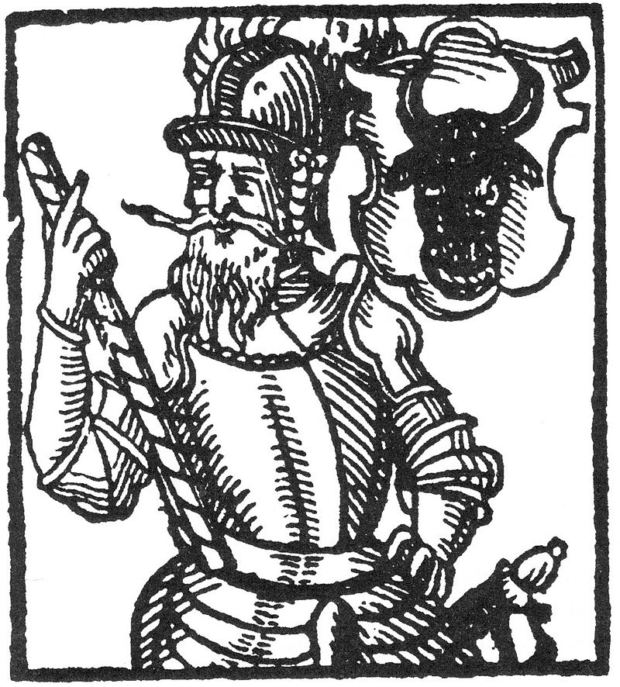
William of Pernštejn (1435-1521)
founded the fishpond register, built fishponds in Moravia and Hluboká nad Vltavou and 215 fishponds in Pardubice
He laid out the 35Km long Opatovická stoka - water from the Elbe
His son Vojtěch wrote pond instructions for carp breeding
Vilém got rich from fish farming
His earnings were 70% from the sale of fish

Slide 4
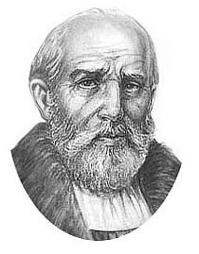
Štěpánek Netolický
(1460–1539)
He built the ponds Opatovický, Horusický, Kaňov, Žabov
Built the Zlata stoka 48 km long (feeds the entire Třeboň system of ponds)
He built 9 large ponds and 37 smaller ones
He preferred to build shallower and nutritious ponds suitable for breeding carp
He was freed from serfdom, the only one from South Bohemia

Slide 5
A revolution in carp breeding
In the middle of the 15th century, individual categories of carp were separated according to age
Division of ponds:
Trdelní (pond for spawning fish)
fry (fry pond for one year old carp)
growth (main ponds: carp were there for two years before reaching market size)

Slide 6
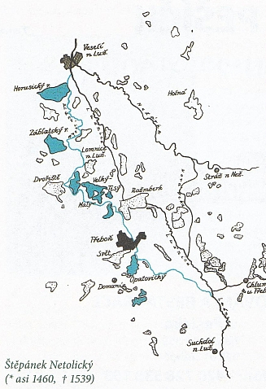
Design of the Třeboň system by Štěpánek Netolický
The ponds from this designed system were completed by J. Krčín

Slide 7
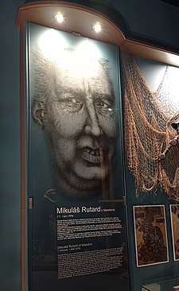
Mikuláš Ruthard of Malešov (?–1576)
Taught by the Pernštejn family
then he worked mainly in Chlum u Třeboně
He established an entire pond system here
He built : Hejtman and Staňkov pond – the drain was cut through solid rock, Nový Kanclíř, Nové jezero)
Subsequently, he was replaced by J. Krčín, who overshadowed his personality in fish farming

Slide 8
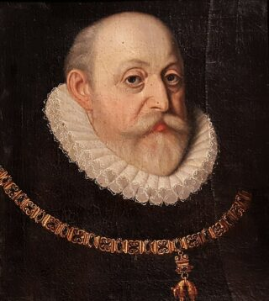
William of Rožmberk (1535-1595)
Supreme Burger and Czech Viceroy
He strongly supported the construction of ponds in Bohemia
He supported the construction of Svět and Rožmberk ponds
He had no heir
After his death, his brother Petr Vok took over the estate

Slide 9
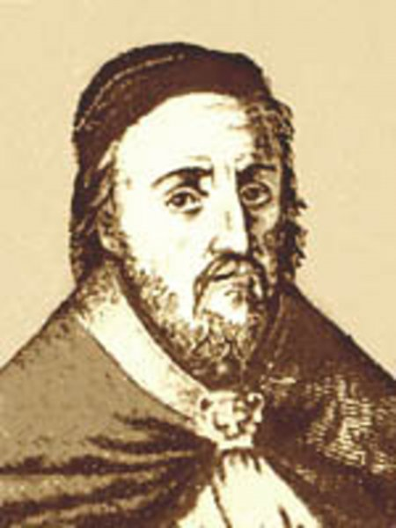
Jan Skála of Doubrava and Hradiště (1486-1553)
wrote five books about ponds and the nature of fish living in them
founded Dubravia's carp spawning method (semi-artificial spawning)

Slide 10
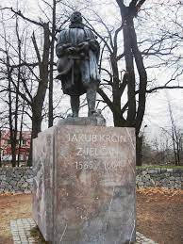
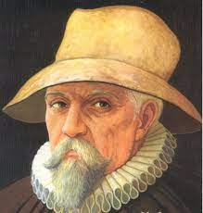
Jakub Krčín of Jelčany and Sedlčany (1535-1604)

Slide 11
Jakub Krčín of Jelčany and Sedlčany (1535-1604)
1562 burger in Krumlov - construction of ponds in Krumlov and Netolice area
1569 Regent of all Rožmberk estates
1571 ponds Svět, Spolský, Potěšil, Opatovický, Dvořiště, Zablatský,
14km The new river prevents flooding of the Rožmberk pond - diverts excess water from Lužnice to Nežárka
1584 Rožumberk Pond
He did not like Petr Vok, he served only his brother Vilém
He had no heir, married twice

Slide 12
Great Riots
Due to the construction of ponds, entire villages were often moved and areas were flooded
With the great building, the work of bond servants also increased
People no longer wanted carp on the menu to such an extent

Slide 13
The end of the golden age of pond farming in Bohemia
After the death of Krčín, pond farming declines
Fish is losing value
There is a return to arable land (drying and filling in of ponds)
1786 – 76,816 ha 1840 – 35,414 ha of ponds.
18th century destruction of entire pond systems
Ponds were defended only in South Bohemia, because they were built on barren wetlands there

Slide 14
2nd Half of the 20th century
Demand for fish is rising again
The nobility begins managing or renting ponds
There is a revolutionary intensification in carp breeding (feeding, liming and fertilization of ponds)
The first pioneer in carp nutrition is Josef Šusta

Slide 15
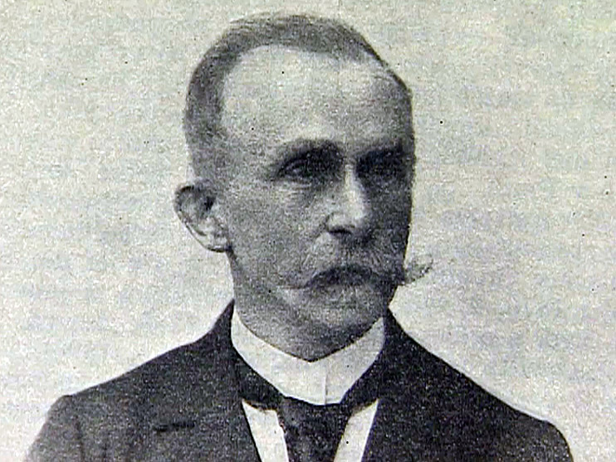
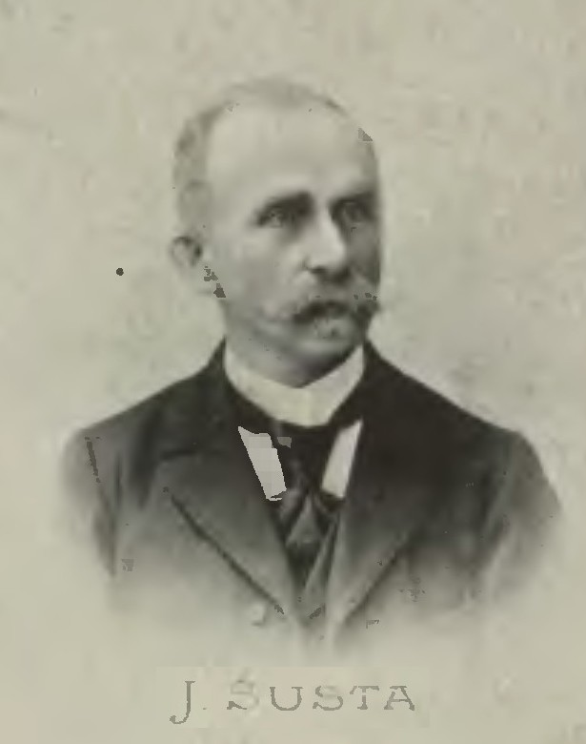
Josef Šusta

Slide 16
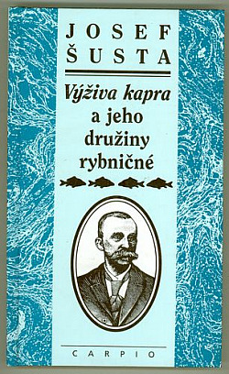
He was the director of the Třeboň estate of Prince Jan Adolf II.
He influenced fishing throughout Europe
Wrote the book Nutrition of a carp and its pond companions
He found out what carp really feed on
Started importing non-native species of fish (whitefish, brown trout, rainbow trout)
He contributed to the development of pike ,perch and whitefish breeding

Slide 17
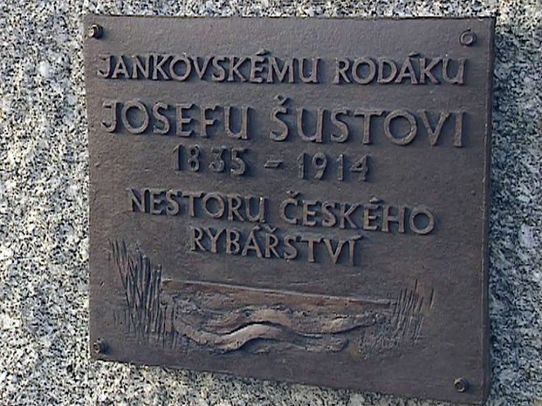
To
J. Šusta
(1835-1914)
native of
Jankov
The founder of Czech fisheries

Slide 18
Decline and rise of fish farming in the 20th century
First World War (28/07/1914 – 11/11/1918)
Second World War (1/9/1939 – 2/9/1945)
Both wars had an adverse effect on fish farming
There was damage to a large part of the ponds system and the suspension of breeding almost all over the Czech territory
The recovery only occurs around 1950
Subsequently, fish farming strengthens every ten years
Today, the Czech Republic has ponds with an area of ​​52,000 ha
Since 2000, approximately 20,000 t of fish have been produced in the Czech Republic each year (roughly 90% are carp)

Slide 19
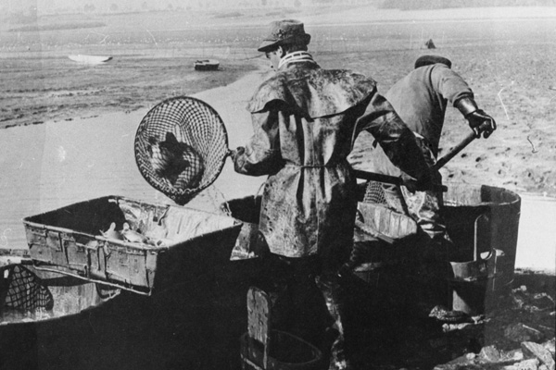
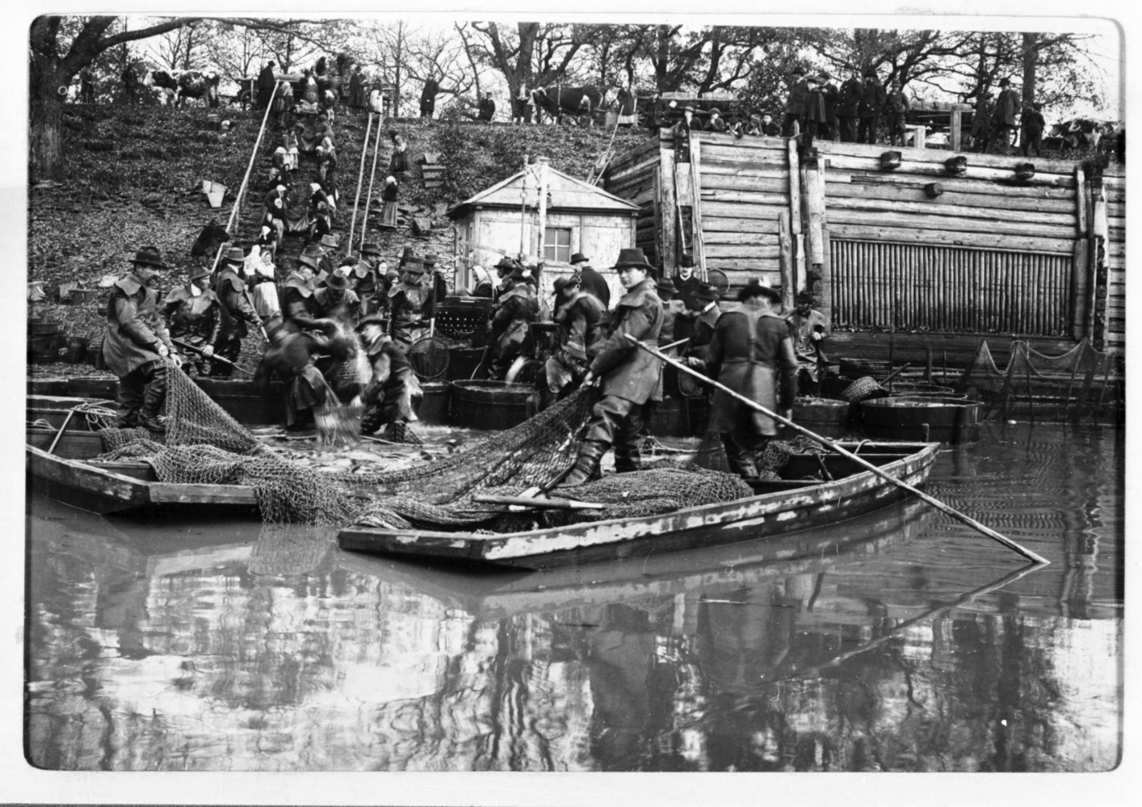
History of fish farming

Slide 20
https://www.cz-ryby.cz

Slide 21
Resources
Pictures:
https://www.nzm.cz/pro-media/tiskove-zpravy/tiskove-zpravy-narodniho-zemedelskeho-muzea-2018/vystava-o-vylovech-rybniku-na-ohrade-tiskova-zprava#gallery-2
https://www.nzm.cz/pro-media/tiskove-zpravy/tiskove-zpravy-narodniho-zemedelskeho-muzea-2018/vystava-o-vylovech-rybniku-na-ohrade-tiskova-zprava
https://cs.wikipedia.org/wiki/Josef_Šusta_(rybníkář)
https://www.csfd.cz/film/397917-otec-ceskeho-kapra/galerie/
http://www.dilarozmberku.12-web.cz/a-5-stepanek-netolicky.html
https://dvojka.rozhlas.cz/326-schuzka-jakub-krcin-z-jelcan-clovek-nerudny-a-mracny-jen-na-rybniky-laskav-7939612
https://epochaplus.cz/tag/vilem-z-pernstejna/
https://epochaplus.cz/vilem-ii-z-pernstejna-zbohatl-na-chovu-kapru/
https://www.gpedia.com/cs/m/gpedia/Mikuláš_Ruthard_z_Malešova

